Slide 1
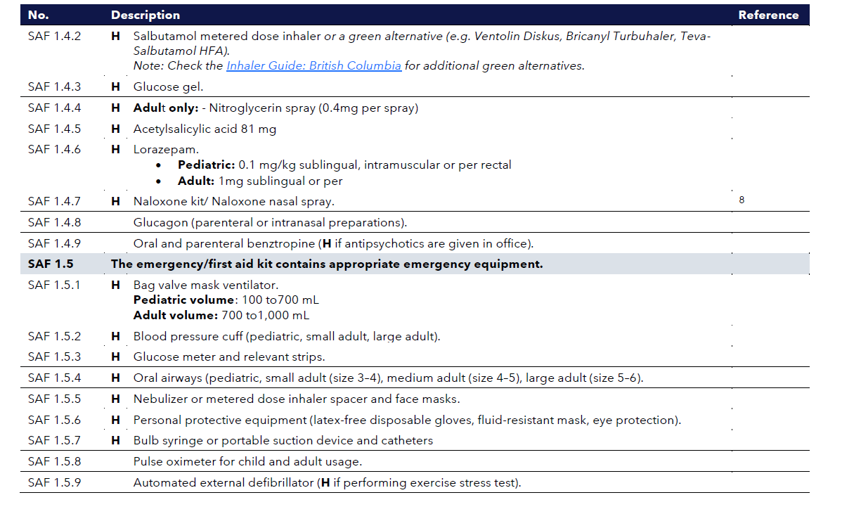
SAF 1.0 EMERGENCY/FIRST AID KIT FOR A MEDICAL EMERGENCY

